Slide 1
Lecture 19: Lewis structures
California State University, Fullerton
2023 Fall Semester – Chem 123

Slide 2
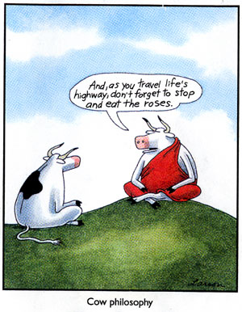
QUESTIONS, COMMENTS, AND CONCERNS?

Slide 3
Outline
Announcements
Highlights prior lecture – Ch 8 and Ch 9
Ch. 10: Covalent Bonds
Drawing Lewis Structures
Resonance and Formal Charges
Exceptions to the octet rule
Polarity of bond

Slide 4
announcements
Still grading exam 2
Online Ch 8+9 Hw is posted and due Tues, Nov 7th at 11:59pm
Chs 8+9 in-class worksheet Tues, Nov 7th due at 11:59pm
Exam 3 coming up Weds, Nov 15th covering Chs 8-10, and part of 11

Slide 5
Outline
Announcements
Highlights prior lecture – Ch 8 and Ch 9
Ch. 10: Covalent Bonds
Drawing Lewis Structures
Resonance and Formal Charges
Exceptions to the octet rule
Polarity of bond

Slide 6
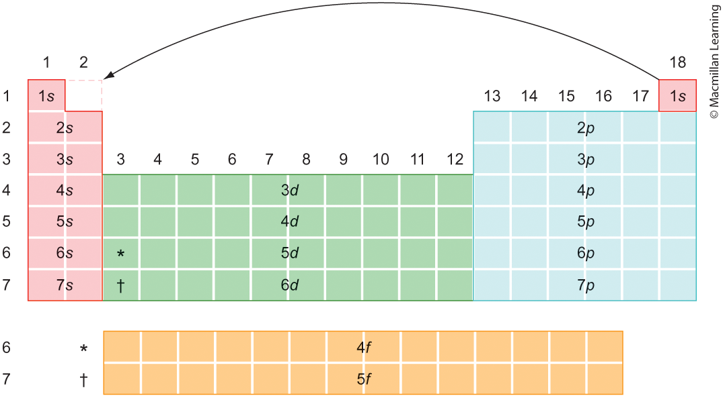
Electron configuration

Slide 7
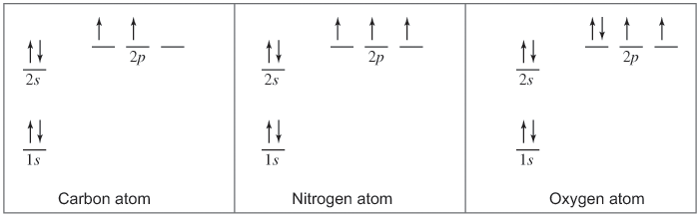
Filling in atomic orbitals with electrons
Aufbau Principle – Electrons in a ground-state atom always fill the lowest-energy position that is available
Hund's Rule – Maximize the total spin of the atom; half-filled and fully-filled atomic orbitals are preferred (lowest energy)

Slide 8
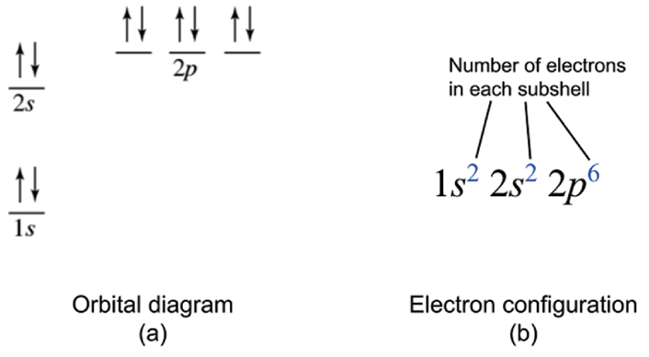
Electron configuration
Shows the arrangement of electrons in order of increasing energy

Slide 9
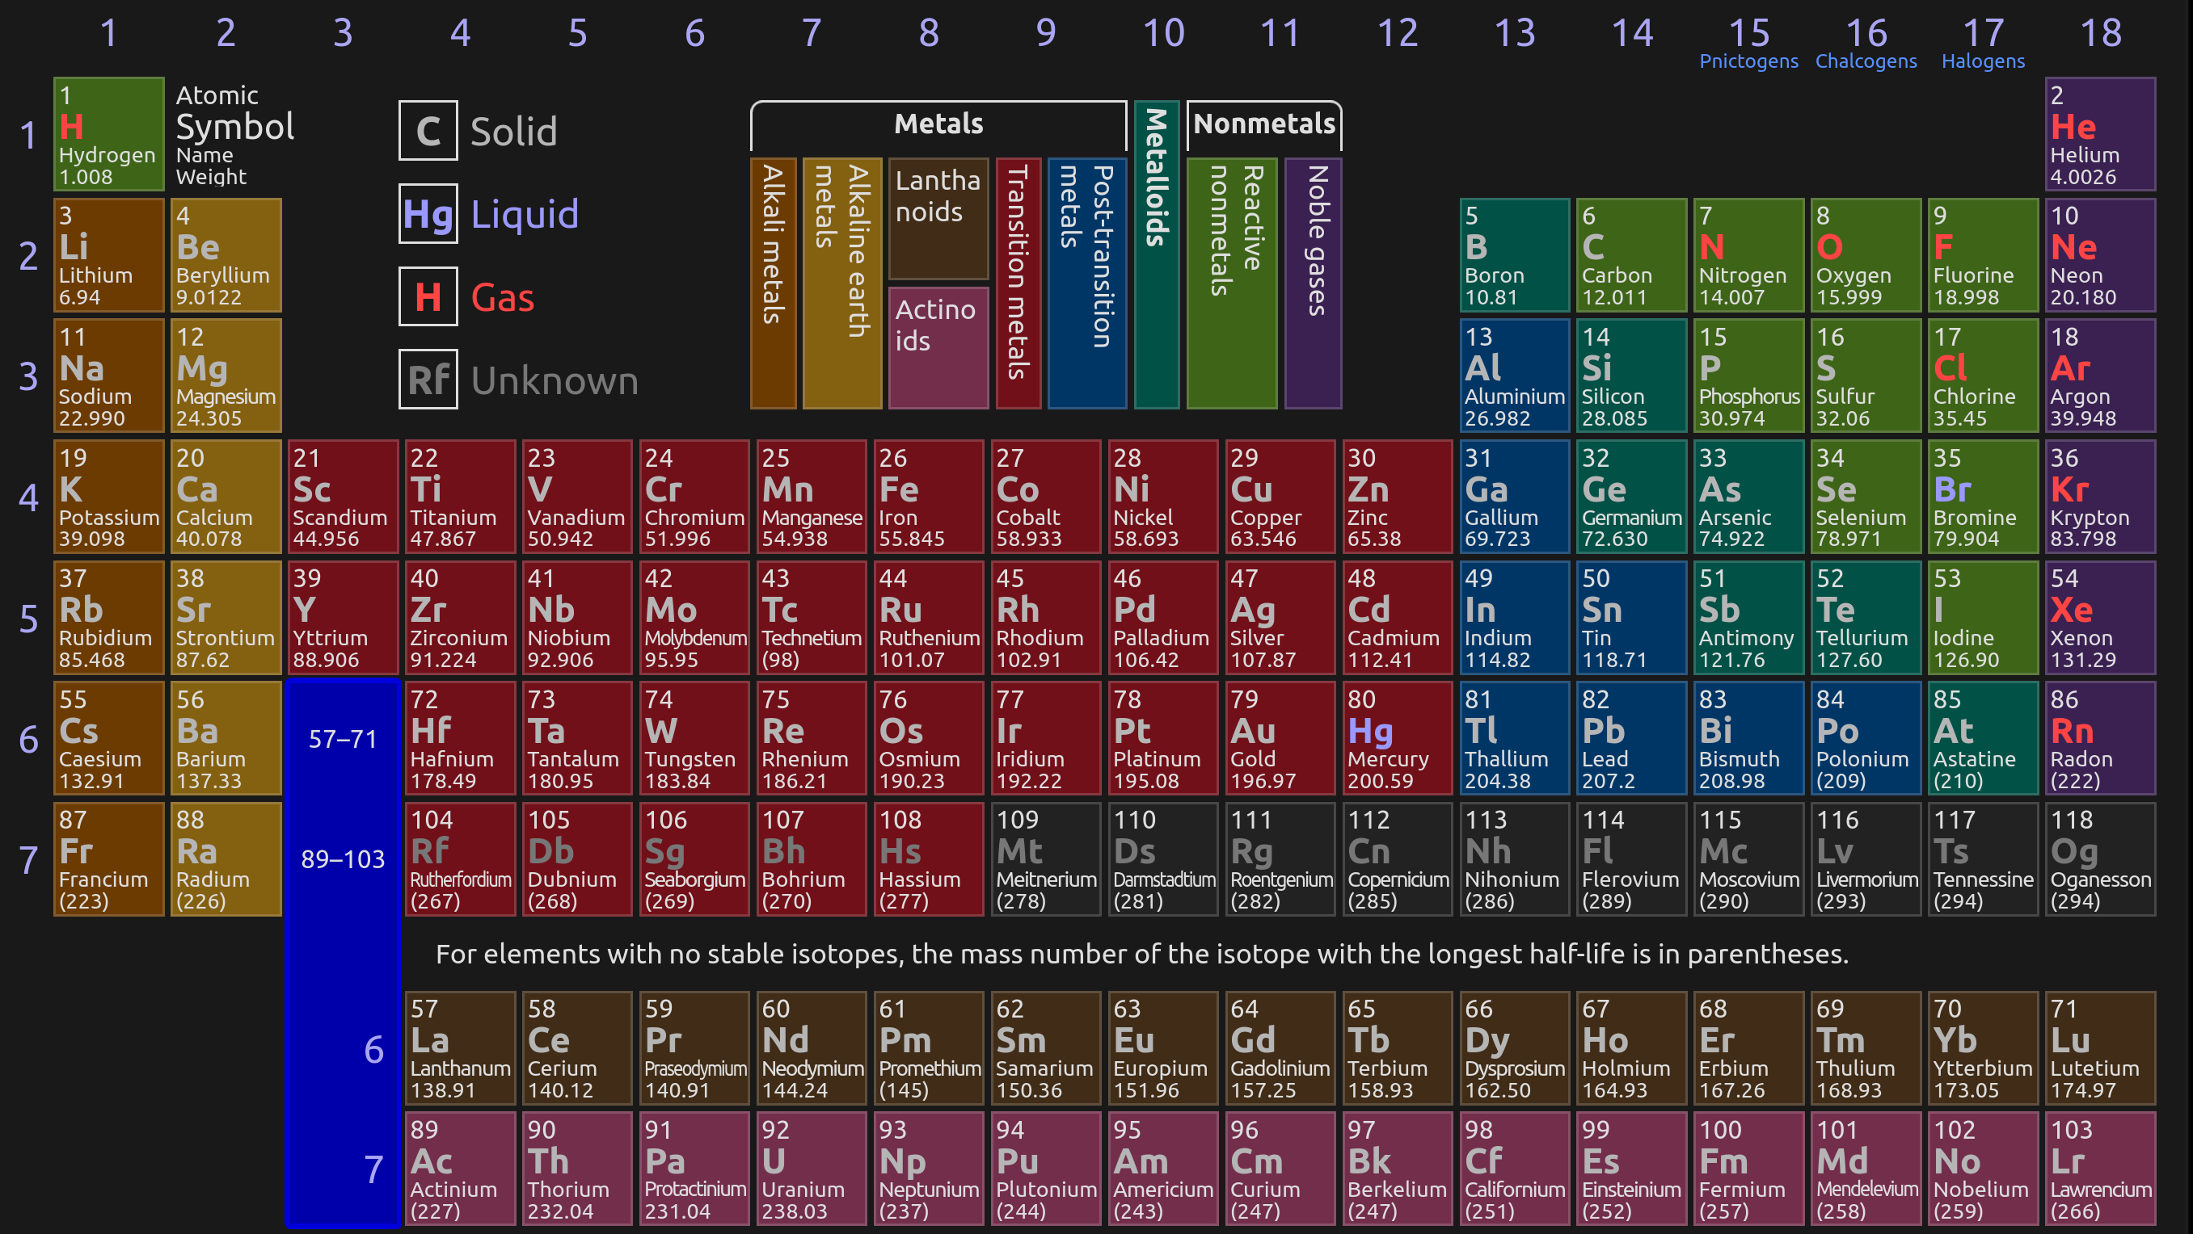
Periodic table – electron configuration

Slide 10
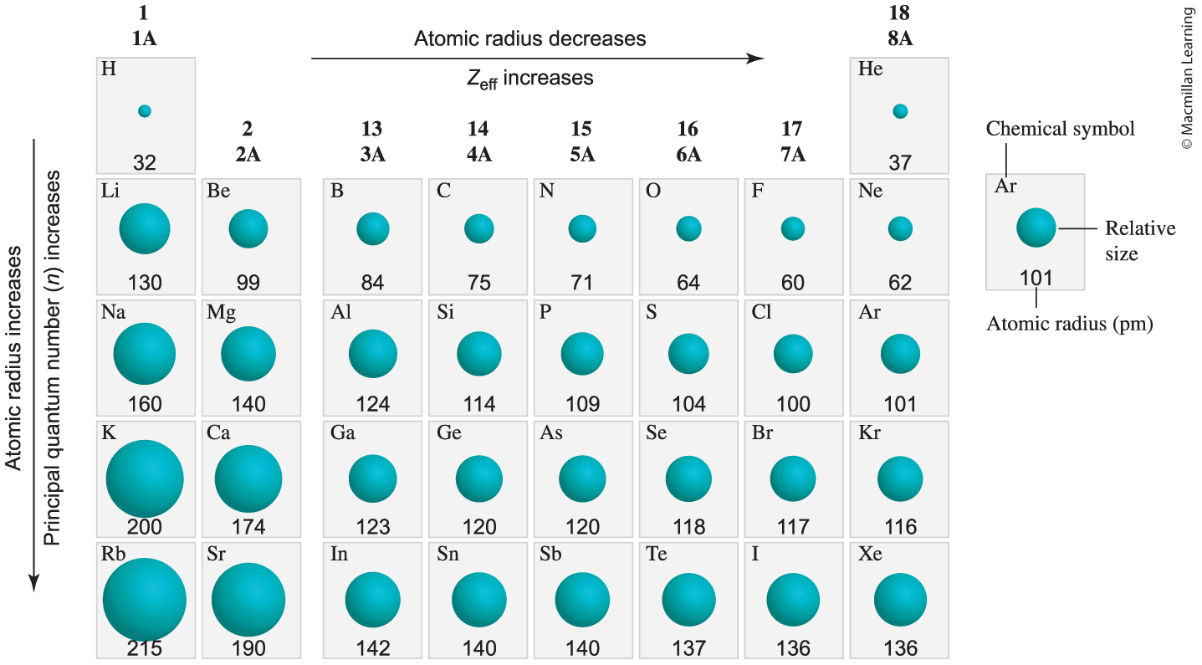
Atomic radius
Size of atom depends on electronic structure – the interactions between the nucleus and electrons

Slide 11
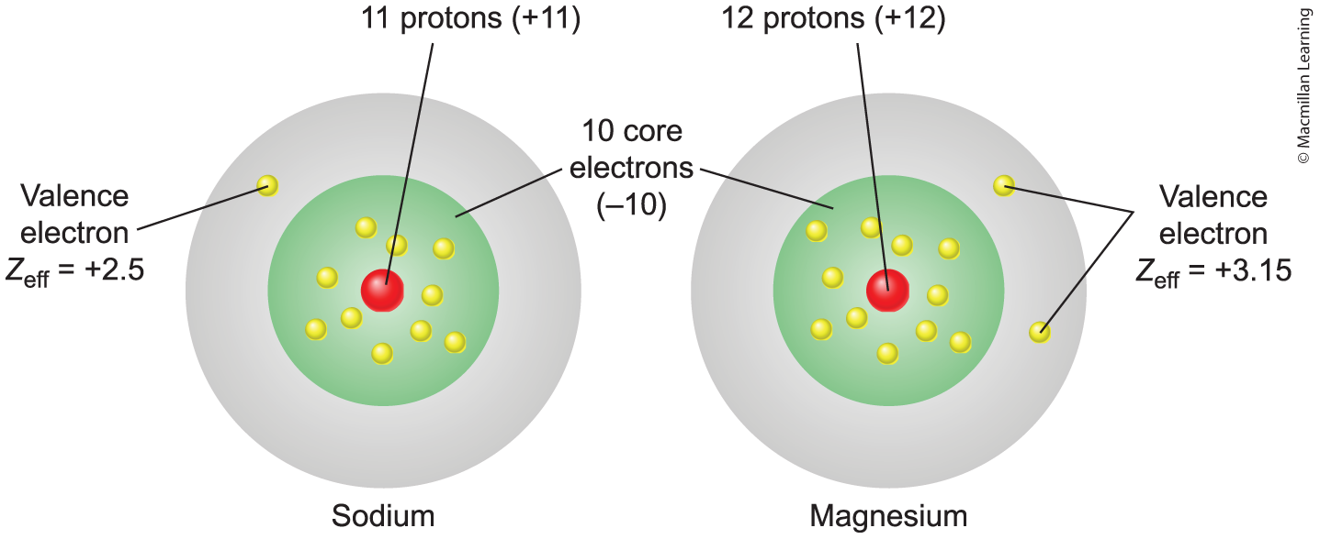
Effective nuclear charge (Z_{eff})
Actual amount of positive (nuclear) charge experienced by an electron in a multi-electron atom

Slide 12
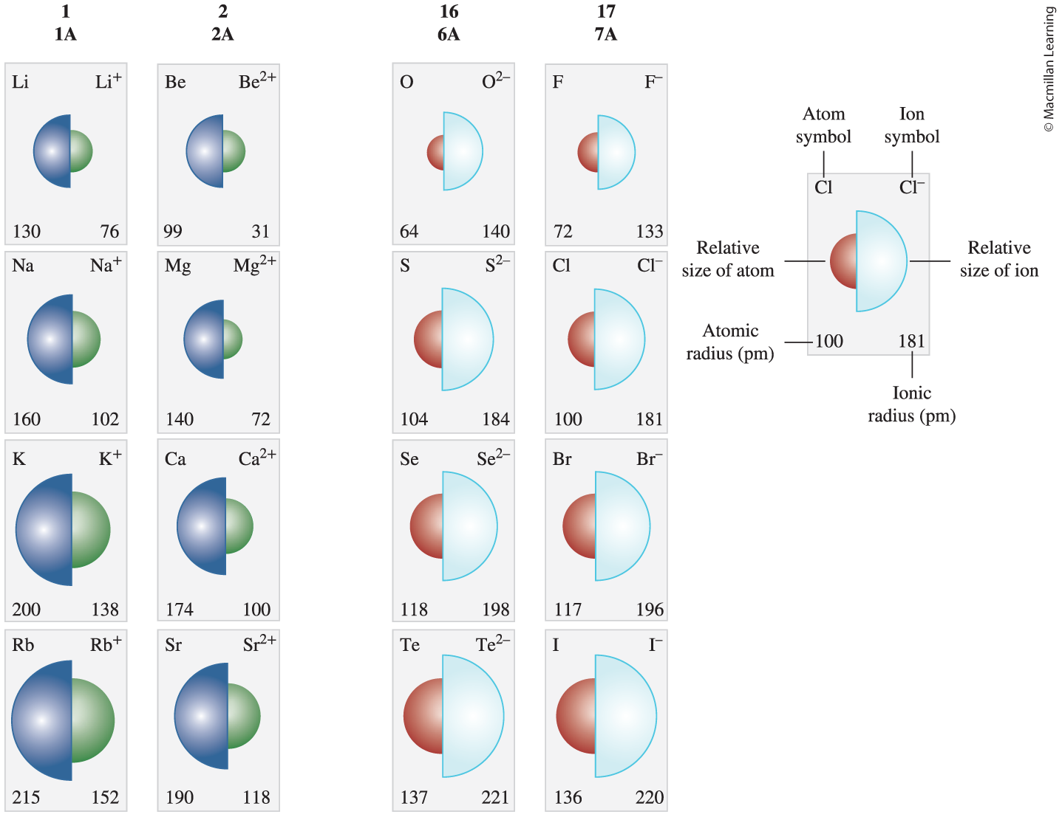
Ionic radius

Slide 13
Ionization energy and electron affinity
Ionization energy – amount of energy to remove an electron from an atom
Electron affinity – energy difference when electron is added to an atom

Slide 14
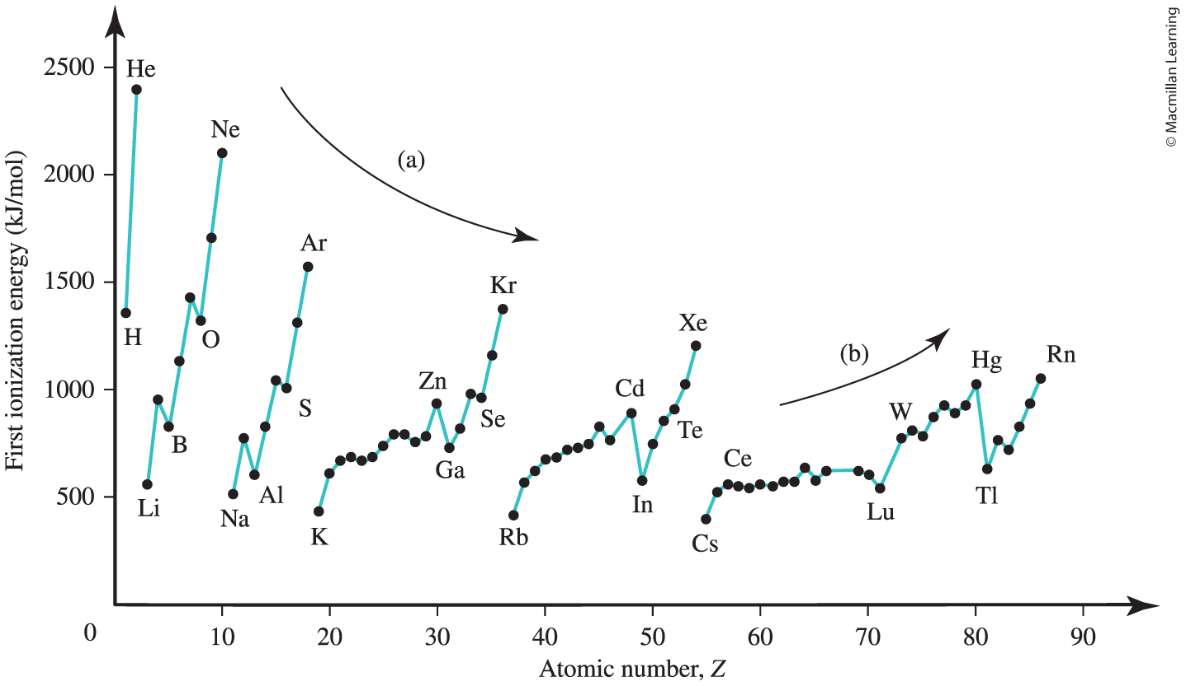
First ionization energy trend

Slide 15
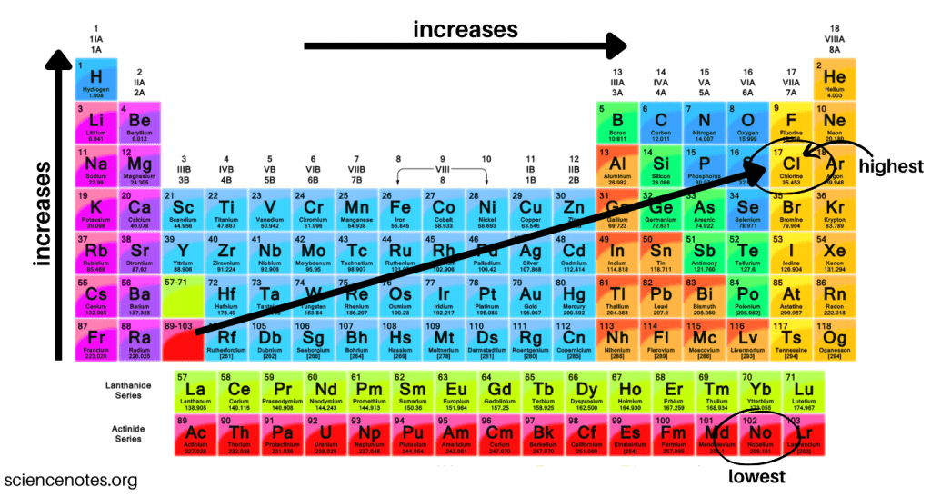
Electron affinity
Q: Why does fluorine have a lower electron affinity than chlorine?

Slide 16
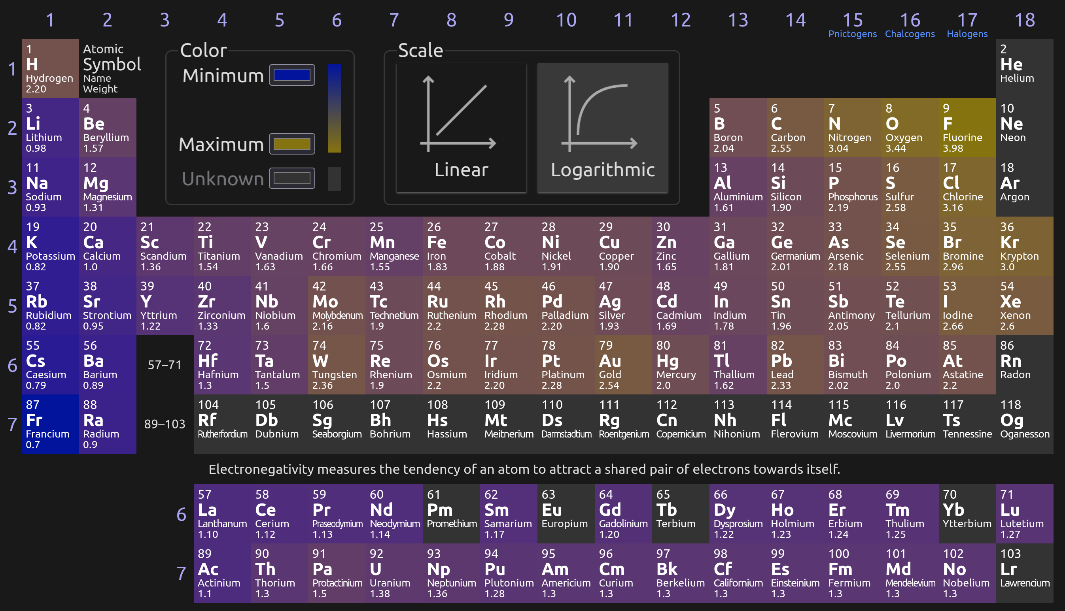
"Quantifying" Electronegativity
Q: Is electronegativity a qualitative or quantitative observation?

Slide 17
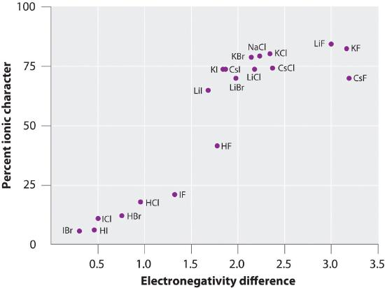
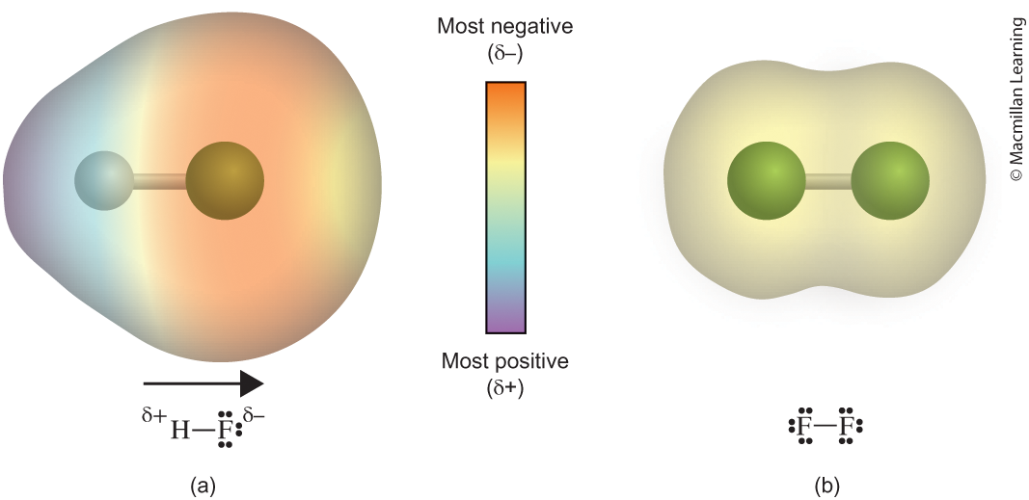
electronegativity
Function of ionization energy and electron affinity
Ionization energy – likelihood of losing electrons
Electron affinity – likelihood of gaining electrons

Slide 18
Outline
Announcements
Highlights prior lecture – Ch 8 and Ch 9
Ch. 10: Covalent Bonds
Drawing Lewis Structures
Resonance and Formal Charges
Exceptions to the octet rule
Polarity of bond

Slide 19
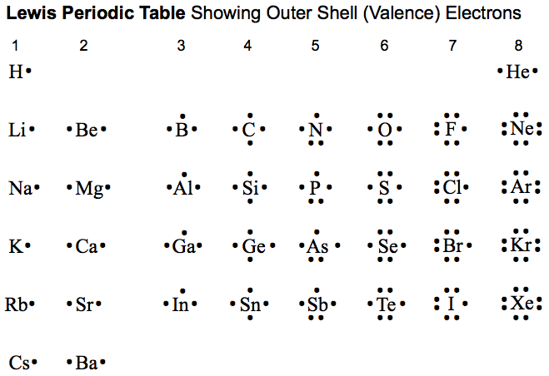
Covalent bonds
Sharing of valence electrons between two atoms

Slide 20
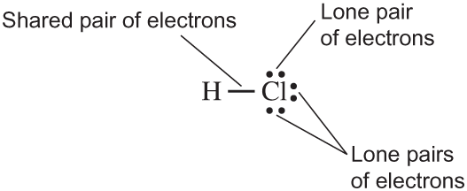
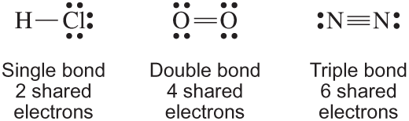
General features Lewis structure
Satisfying the octet rule (8 electrons surrounding the atom) but there are exceptions
Each bond is two electrons shared between atoms (localized)
Lone pairs are not shared between atoms (delocalized)
Strength of bonds: Single < Double < Triple

Slide 21
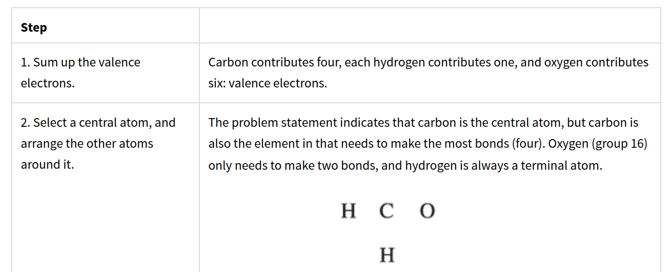
Steps to drawing lewis structures: CH₂O

Slide 22
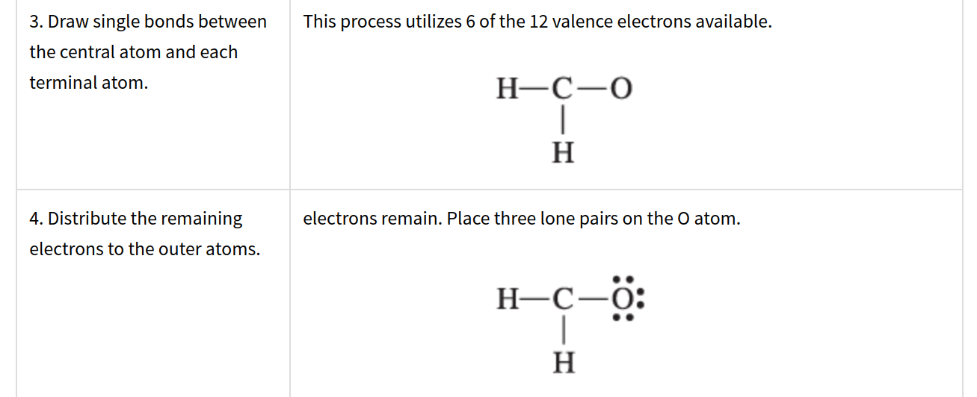
Steps to drawing lewis structures

Slide 23
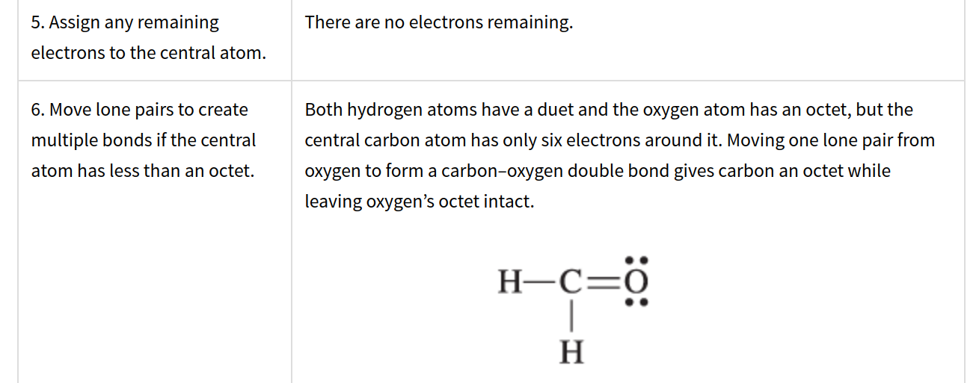
Steps to drawing lewis structures

Slide 24
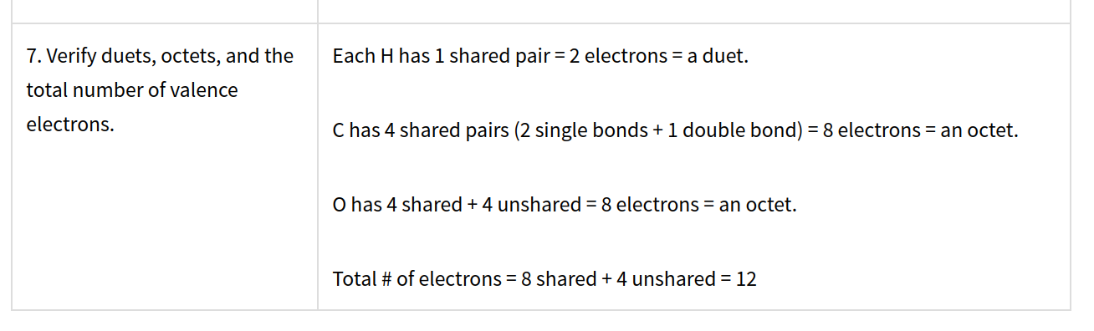
Steps to drawing lewis structures

Slide 25
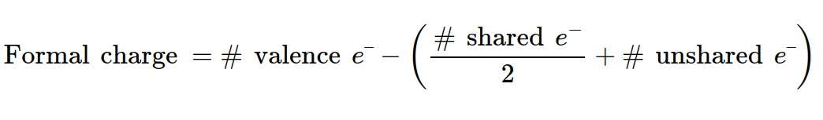
Final check: calculating formal charges
The charge assigned to an atom in a molecule, assuming that electrons in all chemical bonds are shared equally between atoms

